Slide 1


Slide 2
Company Dataset Analysis
In this project, I conducted a comprehensive analysis using a dataset provided by my organization. My goal was to extract valuable insights about the company's departments and employees through a series of targeted SQL queries.
Throughout the project, I explored a wide range of SQL functionalities, enhancing my ability to manipulate and analyze data effectively. In the following slides, I will showcase several key queries that illustrate the depth and breadth of the analysis performed.

Slide 3
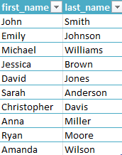
Problem Statement:
Retrieve the first name and last name of all employees.
Query:
SELECT first_name, last_name FROM employee;
Output:

Slide 4
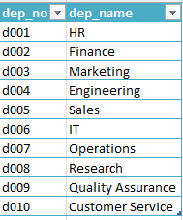
Problem Statement:
Find the department numbers and names.
Query:
SELECT dep_no, dep_name FROM departments;
Output:

Slide 5

Problem Statement:
Get the total number of employees.
Query:
SELECT COUNT(emp_no) AS "Total number of employees" FROM employee;
Output:

Slide 6

Problem Statement:
Find the average salary of all employees.
Query:
SELECT AVG(salary) AS "Average salary of all employees" FROM salaries;
Output:

Slide 7

Problem Statement:
Retrieve the birth date and hire date of employee with emp_no 10003.
Query:
SELECT birth_date, hire_date FROM employee WHERE emp_no=10003;
Output:

Slide 8
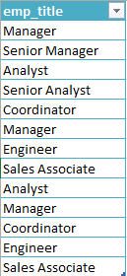
Problem Statement:
Find the titles of all employees.
Query:
SELECT title AS emp_title FROM employee_titles;
Output:

Slide 9

Problem Statement:
Get the total number of departments.
Query:
SELECT COUNT(dep_name) AS 'Total number of departments’ FROM departments;
Output:

Slide 10

Problem Statement:
Find the gender of employee with emp_no 10007.
Query:
SELECT gender FROM employee WHERE emp_no=10007;
Output:

Slide 11
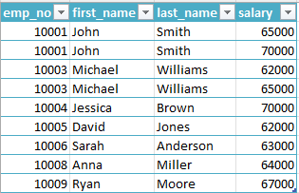
Problem Statement:
Retrieve the employee number, first name, last name, and salary of employees earning more than $60,000.
Query:
SELECT employee.emp_no, employee.first_name, employee.last_name, salaries.salary FROM employee INNER JOIN salaries ON employee.emp_no=salaries.emp_no WHERE salary>60000;
Output:

Slide 12

Problem Statement:
Retrieve the employee number, first name, last name, and title of all employees who are currently managers.
Query:
SELECT employee.emp_no, employee.first_name, employee.last_name, employee_titles.title FROM employee INNER JOIN employee_titles ON employee.emp_no = employee_titles.emp_no WHERE title="Manager";
Output:

Slide 13

Problem Statement:
Retrieve the employee number, first name, last name, and title of employees whose hire date is between '2005-01-01' and '2006-01-01’.
Query:
SELECT employee.emp_no, employee.first_name, employee.last_name, employee_titles.title FROM employee INNER JOIN employee_titles ON employee.emp_no = employee_titles.emp_no WHERE hire_date BETWEEN '2005-01-01’ and '2006-01-01’;
Output:

Slide 14

Problem Statement:
Get the highest salary among all employees.
Query:
SELECT MAX(salary) AS "Highest Salary" FROM salaries;
Output:

Slide 15
Insights from Sample Dataset Analysis
Although this was a sample dataset, the analysis yielded several notable insights:
Company Size and Structure: The dataset represents a small company with 10 distinct departments.
Salary Insights:
Maximum Salary: The highest salary offered by the company is $70,000.
Average Salary: The average salary across all employees is approximately $63,000.
These findings provide a snapshot of the company's departmental structure and compensation trends, offering valuable benchmarks for further analysis and comparison with industry standards.

